Slide 1
John Lewis Invictus Academy
Tuesday, November 15, 2022
GO Team Meeting #3
45 Day Check-in

Slide 2


I. Call to Order
II. Roll Call; Establish Quorum
III. Action Items
a. Approval of Agenda
b. Approval of Previous Minutes: October 18, 2022
c. Update Meeting Calendar February Date
d. Approve Strategic Plan (if needed due to updates during the meeting)
e. Ranking the Strategic Plan Priorities in preparation for the FY 23-24 school budget (to be discussed January-March 2023) - after discussion
IV. Discussion Items
a. 45-Day Continuous Improvement Plan (CIP) Check-in
b. Strategic Plan and Continuous Improvement Plan Alignment
c. Strategic Plan Updates (if needed)
d. Fall ACES Presentation
e. Progress on the Strategic Plan Priorities (return to action item to approve ranking)
V. Information Items
a.. Principal's Report
VI. Announcements
VII. Public Comment
VIII. Adjournment

Slide 3
Agenda
CIP-45 Day Check-in
Fall ACES Presentation
School Strategic Plan
Discussion on Strategic Plan and progress
Updates for Strategic Plan (as necessary)
Preparing for the Budget Development
Rank Strategic Priorities

Slide 4
Timeline for GO Teams
You are HERE
1
2
3
4
5
1
2
3
4
5
Fall 2021
GO Team Developed 2021-2025 Strategic Plan
Summer 2022
School Leadership completed Needs Assessment and defined overarching needs for SY22-23
August 2022
School Leadership completed 2022-2023 Continuous Improvement Plan
Sept. – Dec. 2022
Utilizing current data, the GO Team will review & possibly update the school strategic priorities and plan
Before Winter Break
GO Team will take action (vote) on the school’s strategic plan and vote on the ranked strategic plan priorities for SY23-24 budget discussions.

Slide 5
Quarterly CIP Check-in
As part of the Continuous Improvement process, all APS schools are completing a quarterly check-in for the Continuous Improvement Plans.
Questions to Consider
Based on our year long CIP plan, what are the actions that the school has already completed?​
What data supports the completion of an action step and success criteria (both implementation and student achievement)?

Slide 6
2022-23 JLIA School-Wide Goals
ELA/SS Goals | Math/Science Goals | Whole Child Goal
By May 2023, the following % of students will be Developing and Above Learners on the GA Milestones ELA EOG: ​ 6th Grade: 38% Developing+ Learners ​ 7th Grade: 43% Developing+ Learners ​ 8th Grade: 49% Developing+ Learners ​ 8th Social Studies: 49% of students will be Developing and Above Learners on the GA Milestones Georgia Studies EOG​ ​ | By May 2023, the following % of students will be Developing and Above Learners on the GA Milestones Math EOG: ​ 6th Grade: 38% Developing+ Learners ​ 7th Grade: 43% Developing+ Learners ​ 8th Grade: 45% Developing+ Learners​ 23% of students will be Developing and Above Learners on the GA Milestones 8th Science EOG ​​ 8th Science: 23% of students will be Developing and Above Learners on the GA Milestones 8th Science EOG ​ 78% of students will be Developing and Above Learners on the GA Milestones HS Physical Science EOG ​ | The percentage of chronically absent students (rates less than 90%) will decrease by 5 percentage points from 64% in May 2022 to 59% by May 2023. ​ ​ ​

Slide 7
Strategic Plan for Instruction
Action Step​ | Person/Position Responsible​ | Timeline | Evidence and Artifacts ​ | APS 5​
Launch Humanities course in 6th and 7th grade to provide daily interdisciplinary learning opportunities in the content areas of ELA & Soc. Studies. ​ | Mr. Dallas, Ms. Morgan​ | August - May​ | Humanities LPs, classroom observations ​ | Signature Programming, Curriculum & Instruction ​
Implement Tier 1 Intervention program, aligned to APS Standards of Service, in ELA/Humanities & Math classes daily with fidelity. ​ | Dr. Harrell, Int.Coord. ​ Mr. Dallas - ELA IC ​ Ms. Graves - Math IC ​ | August - May ​ | Tier 1 Intervention lessons HMH data reports, Tier 1 Intervention training session materials​ | Whole Child & Intervention, Curriculum & Instruction ​
Implement classroom strategies aligned to the Personalized Learning core elements of Targeted Instruction and Student Reflection & Ownership. ​ | ICs, ​ Ms. Morgan - STEAM​ Mrs. Bright - VILS​ | August - May ​ | Student Data Trackers/Reflections, LPs with Small Group Instruction | Personalized Learning, Curriculum & Instruction ​
Implement No-Nonsense Nurturer Approach as school-wide behavior management system in all classrooms so that teachers can build a positive learning environment. | ICs ​ | August - May ​ | NNN training session materials, classroom observation data, coaching cycle tracker​ (KickUp) | Curriculum & Instruction, Whole Child ​
Implement Accelerated Reader to foster students love of reading and accelerate students’ reading growth. ​ | Ms. Eppinger - Media Specialist​ | August - May ​ | Accelerated Reader Reports ​ | Curriculum & Instruction ​
Notes:
We are implementing a lot of other content-specific strategies too. :) This is a high-level overview and not exhaustive.
Math:
Implementing Amplify Math and implementing manipulatives
Science:
Using STEMscope curriculum to

Slide 8
Strategic Plan for Instructional Support
Action Step​ | Person/Position Responsible​ | Timeline | Evidence and Artifacts ​ | APS 5​
Facilitate weekly Interdisciplinary PLCs to build teachers’ knowledge & skills in order to implement PBLs 2x during the school year.​ | Ms. Morgan​ | August - May ​ | PLC agendas & session slides, PBL plans, STEAM Journals, student PBL products​ | Signature Programming, Curriculum & Instruction ​
Facilitate content PLCs 2x weekly for collaborative planning, DDI, and analyzing student work. Provide LP feedback weekly. Coach PLC Leads to implement PLC best practices using the PLC+ framework. ​ | ICs | August - May ​ | PLC agendas, LPs, Reteach Action Plans, Data Forms, PLC+ Framework session materials​ | Curriculum & Instruction, Data ​
Conduct biweekly data analysis on common assessments to identify targeted students and standards to build incorporate remediation planning into daily instructional frameworks. | ICs & ​ Dr. Harrell - Testing Coord.​ | August - May ​ ​ | Grade Level Data Walls, Teacher Data Forms, Reteach Action Plans ​ | Curriculum & Instruction, Data ​
Provide 1:1 coaching to all JLIA teachers to increase the rigor and engagement in classrooms. ​ | ICs | August - May ​ | Coaching trackers, teacher observation data​ | Curriculum & Instruction ​
Provide trainings & PL on topics that are in service of PBLs and Personalized Learning, including data analysis & reports. ​ | Small ILT | August - May ​ | PL session materials​ | Curriculum & Instruction, Signature Programming, Data ​

Slide 9
Strategic Plan for Whole Child
Action Step​ | Person/Position Responsible​ | Timeline | Evidence and Artifacts ​ | APS 5​
Assemble a Student Attendance Committee (SAC) that meets weekly to ensure implementation of school-wide attendance policies/protocols with fidelity and identifies and addresses barriers to student attendance. | Mr. Clark - AP | August - May ​ | Attendance Team Meeting Agendas/Minutes, Call Logs ​ | Whole Child & Intervention ​
Assemble a Care Team that meets weekly to identify and address barriers to student wellness and student success. | Ms. Miller - SEL Coach ​ | August - May ​ | Care Team Meeting Agendas/Minutes | Whole Child & Intervention
Identify most at-promise students through attendance, discipline, and academic data and assign student caseloads to support staff (Game Changers) for weekly mental, emotional, & behavioral monitoring/support. ​ | Ms. Miller - SEL Coach ​ | August - May ​ | Student Cohort Trackers ​ | Whole Child & Intervention ​
Implement ISS Program that includes academics, SEL, restorative practices, & wraparound service supports to students. ​ | Mr. Huff - SEL Teacher​ | August - May ​ | ISS Program Overview​ | Whole Child & Intervention ​

Slide 10

Accountability
Collaboration
Equity
Support
Fall 2022 ACES Presentation

Slide 11
Strategic Plan Progress

Slide 12
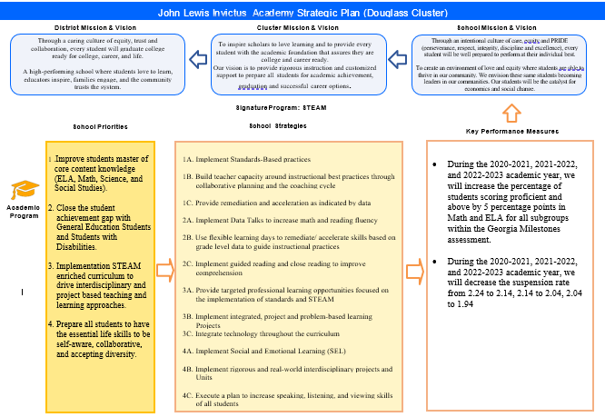
School Name
Mission
Vision
SMART Goals
TBD
TBD
TBD
TBD
APS Strategic Priorities & Initiatives
School Strategic Priorities
School Strategies
Insert School’s Current Strategic Plan
1A. tbd
1B. tbd
1C. tbd
Fostering Academic Excellence for All Data
Curriculum & Instruction Signature Program
Building a Culture of Student Support
Whole Child & Intervention Personalized Learning
TBD: tbd
TBD: tbd
4.
Equipping & Empowering Leaders & Staff
Strategic Staff Support Equitable Resource Allocation
6.
7.
TBD: tbd
Creating a System of School Support
Strategic Staff Support
Equitable Resource Allocation
8.
9.
TBD: tbd
14

Slide 13
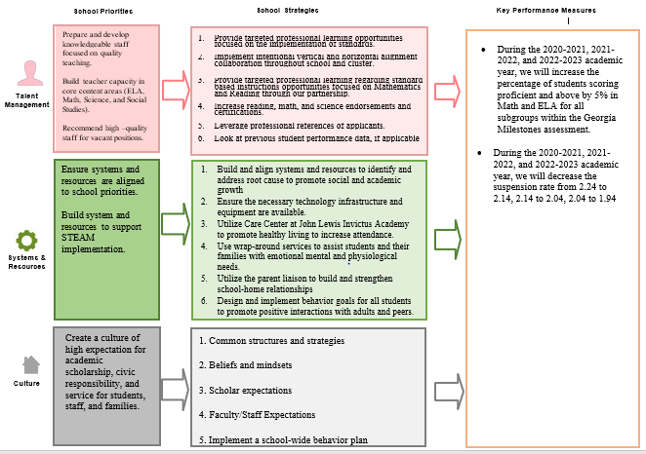
School Name
Mission
Vision
SMART Goals
TBD
TBD
TBD
TBD
APS Strategic Priorities & Initiatives
School Strategic Priorities
School Strategies
Insert School’s Current Strategic Plan
1A. tbd
1B. tbd
1C. tbd
Fostering Academic Excellence for All Data
Curriculum & Instruction Signature Program
Building a Culture of Student Support
Whole Child & Intervention Personalized Learning
TBD: tbd
TBD: tbd
4.
Equipping & Empowering Leaders & Staff
Strategic Staff Support Equitable Resource Allocation
6.
7.
TBD: tbd
Creating a System of School Support
Strategic Staff Support
Equitable Resource Allocation
8.
9.
TBD: tbd
14

Slide 14
Activity & Discussion
Review the priorities and goals in your strategic plan and reflect on if the expected progress is being made. These guiding questions will help you determine what, if any, updates are needed for your school’s strategic plan.
Are all CIP Goals reflected in our Strategic Plan Priorities? If not, which CIP Goal(s) are missing and should be added to the Strategic Plan?
What progress has been made towards the priorities identified in our Strategic Plan? What evidence/data do we have?
Based upon available data, are there any other adjustments we need to make to the Strategic Plan?

Slide 15
Updates to the
Strategic Plan
Enter all changes/updates to your plan – be sure to include accountability measures, as appropriate.

Slide 16
Questions?
Wonderings?
Comments?

Slide 17
Preparing for
Budget Development

Slide 18
You are HERE
1
2
3
4
5
1
2
3
4
5
Fall 2021
GO Team Developed 2021-2025 Strategic Plan
Summer 2022
School Leadership completed Needs Assessment and defined overarching needs for SY22-23
August 2022
School Leadership completed 2022-2023 Continuous Improvement Plan
Sept. – Dec. 2022
Utilizing current data, the GO Team will review & update the school strategic priorities and plan, as needed
Before Winter Break
GO Team will take action (vote) on the school’s strategic plan and vote on the ranked strategic plan priorities for SY23-24 budget discussions.

Slide 19
Action on the Updated Strategic Plan
The GO Team needs to TAKE ACTION (vote) on its updated Strategic Plan. After the motion and a second, the GO Team may have additional discussion. Once discussion is concluded, the GO Team will vote.

Slide 20
Discussion
Strategic Plan Priority Ranking
In preparation for the 2023-2024 Budget Development (January–March 2023), the GO Team needs to rank its Strategic Plan Priorities. Use the next slide to capture the priority ranking.

Slide 21
Strategic Plan
Priority Ranking
Insert the school’s priorities from Higher to Lower
Higher
Academic Programs
Talent Management
Culture
Systems/Resources
Lower

Slide 22
Action on the Strategic Plan Priorities
The GO Team needs to TAKE ACTION (vote) on its ranked Strategic Plan Priorities. After the motion and a second, the GO Team may have additional discussion. Once discussion is concluded, the GO Team will vote.

Slide 23
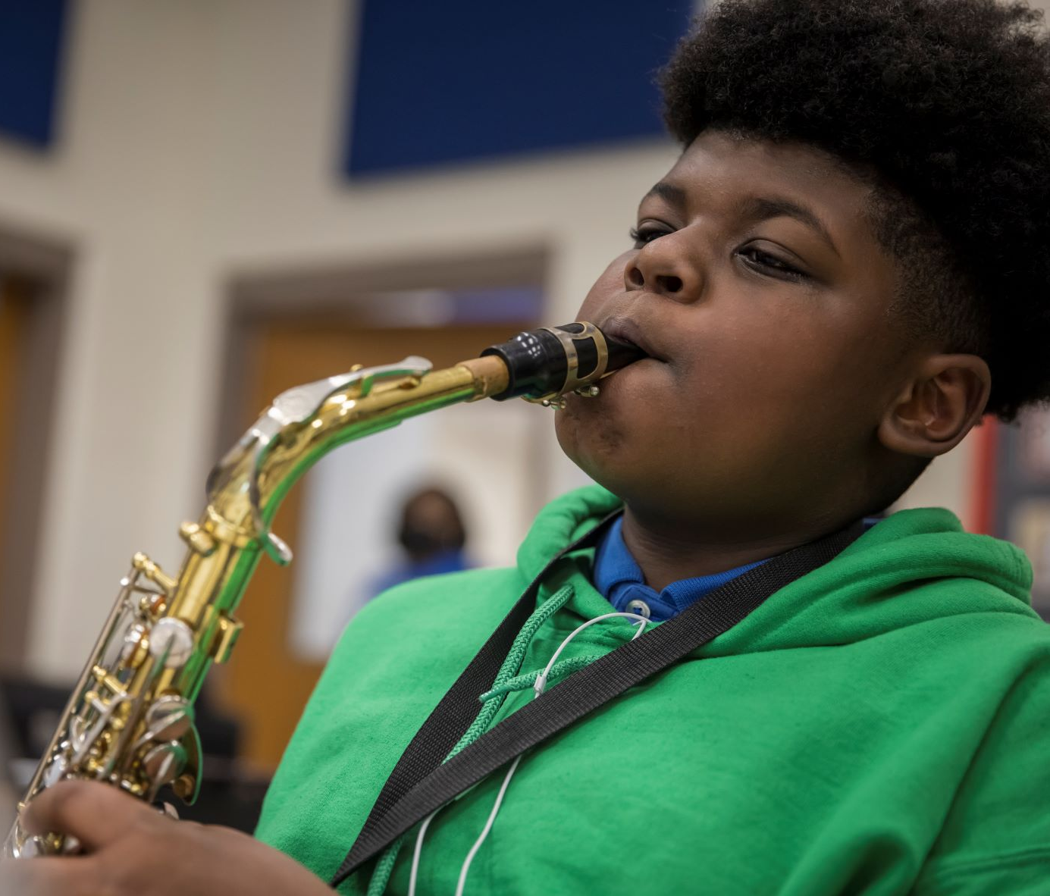

Where we’re going
At our next meeting(s) we will begin the discussion of the 2023-2024 budget.
Let me or the Chair know of any additional information you need for our future discussion.
Our next meeting is scheduled for
Tuesday, January 24, 2023
HAPPY HOLIDAYS!

Slide 24
Thank you

